Slide 1
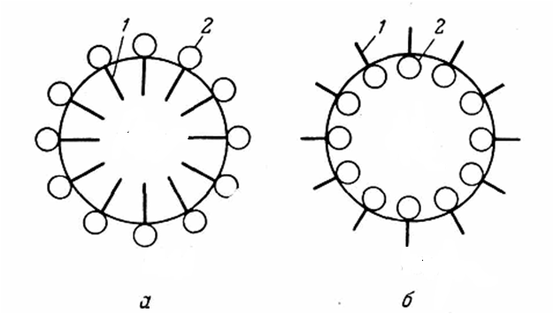
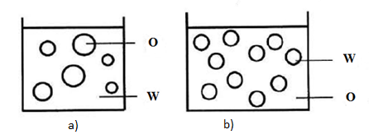
Lecture 15 Properties and classification of emulsions. Suspensions, foams, aerosols.
Emulsions.
Adilbekova A.O

Slide 2
Emulsion are the colloidal solutions in which both the dispersed phase and the dispersion medium are liquids
Emulsions are thermodynamically unstable systems, so for stabilization of emulsions emulsifying agents are used. Surface active agent molecules stabilize an emulsions due to their amphiphilic structure

Slide 3
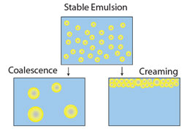

Slide 4
Classification of emulsions
Oil-in-water emulsions (O/W) : The emulsion in which oil is present as the dispersed phase and water as the dispersion medium (continuous phase) is called an oil-in-water emulsion. Milk is an example of the oil-in-water type of emulsion. In milk liquid fat globules are dispersed in water. Other examples are, vanishing cream etc.
Water-in-oil emulsion (W/O) : The emulsion in which water forms the dispersed phase, and the oil acts as the dispersion medium is called a water-in-oil emulsion.
These emulsion are also termed as oil emulsions. Butter and crude oil emulsions, cosmetic creams are typical examples of this types of emulsions.

Slide 5
Classification of emulsions
Multiple emulsions
Water-in-oil-in-water emulsion (W/O/W)
Oil-in-water-in-oil emulsions (O/W/O)

Slide 6
The type of emulsion can be determined by dilution test, dye solubility test, and electrical conductivity test.
The dilution test is based on the principle that an emulsion can be diluted with its continuous phase. If water is added to an O/W emulsion, the emulsion is diluted indicating that water is the continuous phase. In contrast, if water is added to a W/O emulsion, the emulsion is not diluted and the separation is apparent.

Slide 7
The dye solubility test is based on the principle that water-soluble dye will be dispersed in aqueous phase and oil-soluble will be dispersed in the oil phase of an emulsion. For example, if a water-soluble dye is added to an emulsion, and if the dye diffuses uniformly throughout the emulsion, water is the continuous phase and it will be an O/W emulsion.
The principle underlying the electrical conductivity test is that water conducts an electric current and oils do not.

Slide 8
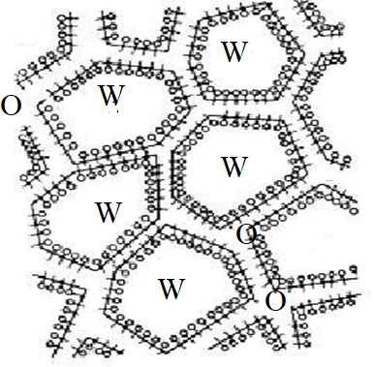
Classification according to concentration of dispersed phase
Diluted emulsions C< 0,1% ( r=10⁻⁷m, aggregative stable, coalescence probability is low )
Concentrated emulsions (0,1 - 74 %) (r>10⁻⁶m)
Highly concentrated emulsions(> 74%) , droplets of dispersed phase are dephormed, no sedimentation, structured like gels.
(butter, bitumen, a highly concentrated 99% emulsion can be formed if benzene is added to a 1% solution of sodium oleate,)

Slide 9
To prepare reasonably stable emulsions, a third component - an emulsifying agent (or emulsifier) - must be present. The materials which are most effective as emulsifying (and foaming) agents can be broadly classified as:
1. Surface-active materials.
2. Naturally occurring materials.
3. Finely divided solids.
The generalisation that 'the phase in which the emulsifying agent is the more soluble tends to be the dispersion medium' is known as Bancroft's rule. Inversion of emulsions.

Slide 10
The amphiphilic nature of many emulsifying agents can be expressed in terms of an empirical scale of so-called HLB (hydrophile-lipophile balance) numbers.
HLB=mass.%ethylene oxide/5 (Griffin formule)
HLB=7+∑HLB hydrophilic + ∑HLB hydrophobic (Davies)

Slide 11
Hydrophilic groups |  | Hydrophobic groups
Group | HLB | group | HLB
-SO₄Na | 35,7 | -CF₃ | -0,870
-COOK | 21,1 | -CF₂ | -0,870
-COONa | 19,1 | -CH₃ | -0,475
=N= | 9,4 | -CH₃ | -0,475
-COOH | 2,4 | -CH₂- | -0,475
-OH | 1,9 | =CH- | -0,475
-O- | 1,3 | =C= | -0,475

Slide 12
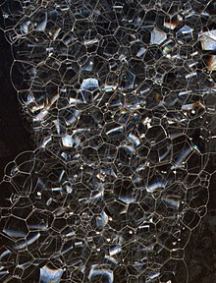
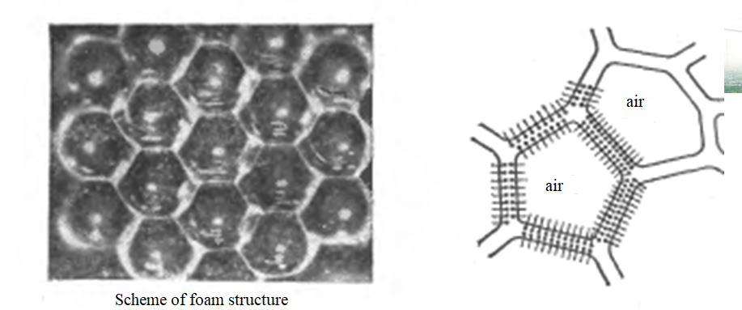
Foams - G/L dispersions
Liquid foams
Multiplicity of foams
Multiplicity of foam (MF) is the ratio of the initial volume of the foam to the volume of the solution spent for the creation of foam
Solid foams

Slide 13
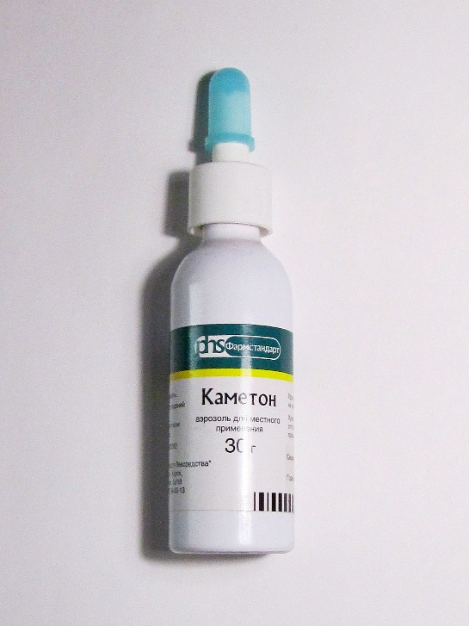
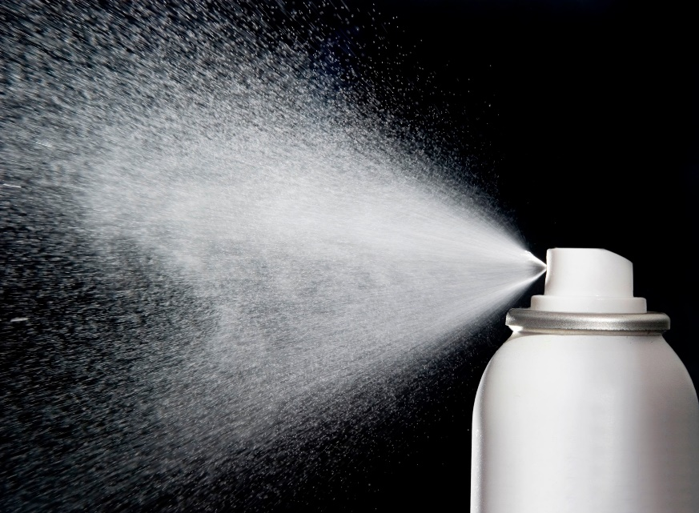
An aerosol is a dispersion of fine solid particles or liquid droplets in air or another gas

Slide 14
Thank you for your attention!

